Slide 1
WELCOME
To our group presentation

Slide 2
Prepared By
Snake Charmers
Al Amin (132-15-2625)
Md. Waliullah (132-15-2788)
Parvez Hossain(132-15-2755)
Tasfia Jaki (132-15-2784)

Slide 3
Presentation Topic
Lab Project : Snake Game

Slide 4
About snake game
Snake is a video game concept which originated during the late 1970s in arcades. The name applies to the general game design; the original was not named Snake, and there is no definitive version of the game. Its simplicity has led to many implementations of the Snake concept. After it became the standard pre-loaded game on Nokia mobile phones in 1998, there was a resurgence of interest in the game as it found a larger audience.

Slide 5
How to play the game…
The player controls a dot, square, or object on a bordered plane. As it moves forward, it leaves a trail behind, so that it resembles a moving snake. In some games the end of the trail is in a fixed position, so the snake continually gets longer as it moves. In another common scheme the snake has a specific length, so there is a moving tail a fixed number of units away from the head. The player loses when the snake runs into either the border of the screen or the trail left by the snake. In another common scheme the snake has a specific length, so there is a moving tail a fixed number of units away from the head. The player loses when the snake runs into either the border of the screen or the trail left by the snake.

Slide 6
Why in java…
We are who learning java, we know that java is portable because java can work on all type of machine. So after creating snake game in java we can play it with any type of smart phone or pc. That’s why we have planed to create snake game with java.

Slide 7
Serial | Methods with Description
1 | public class Main{ It is for create Main class.
2 | public class Snake extends JPanel{ It is use for create class
3 | snake (){ Initialize all variable
4 | public void init() { Creat menubar with function
5 | public void resetDefaultValues(){ when starting new game
6 | Public void moveSnakeForword(){ Snake moves forword
7 | Public void snakeKeyPressed(KeyEvent e){ Controlling snake using specific keys of the keyboard
8 | Public void runIt(){ Process what should be next step of the snake
9 | public void run() { Move the snake move forward. In the start of the game snake move left to right, if player press up, down, right or left arrow snake change its direction according to pressed arrow

Slide 8
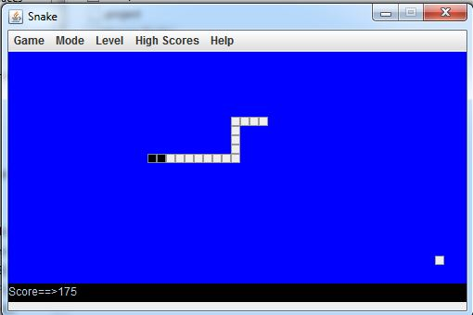
Screen shot of the Game

Slide 9
Thank You ☺

